Slide 1
Git and GitHub
Atul Kahate

Slide 2
Version Control
Tracks changes over time
Restores previous versions
Maintains a history of changes
Supports collaboration
Improves software development

Slide 3
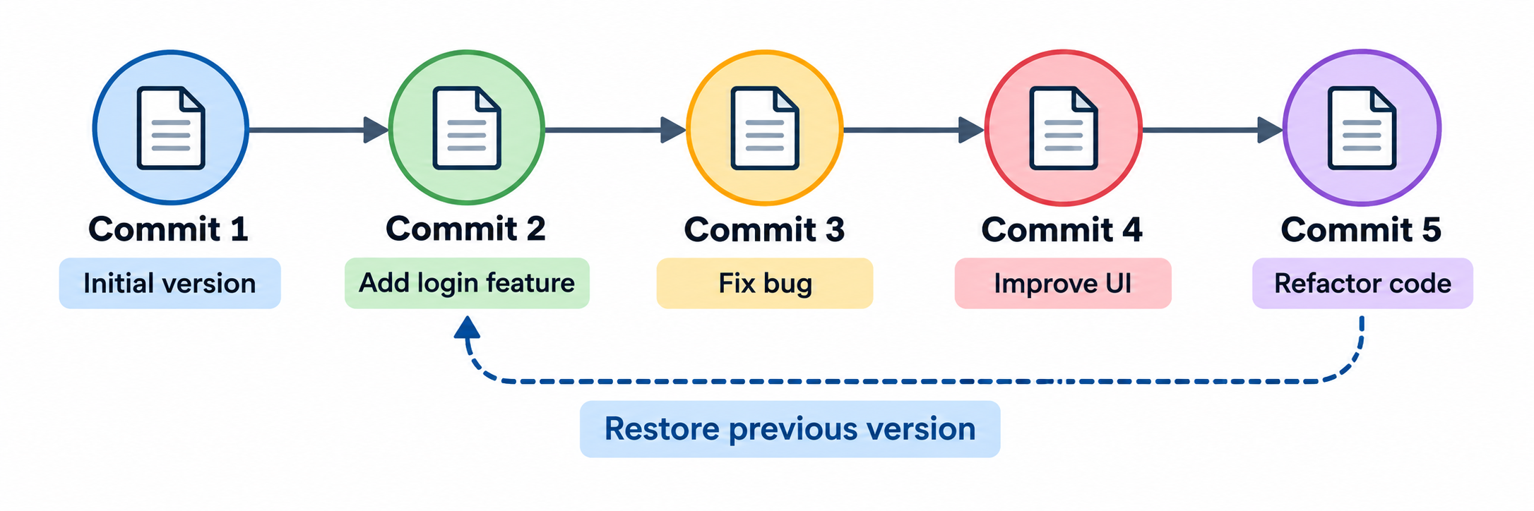
How Version Control Works

Slide 4
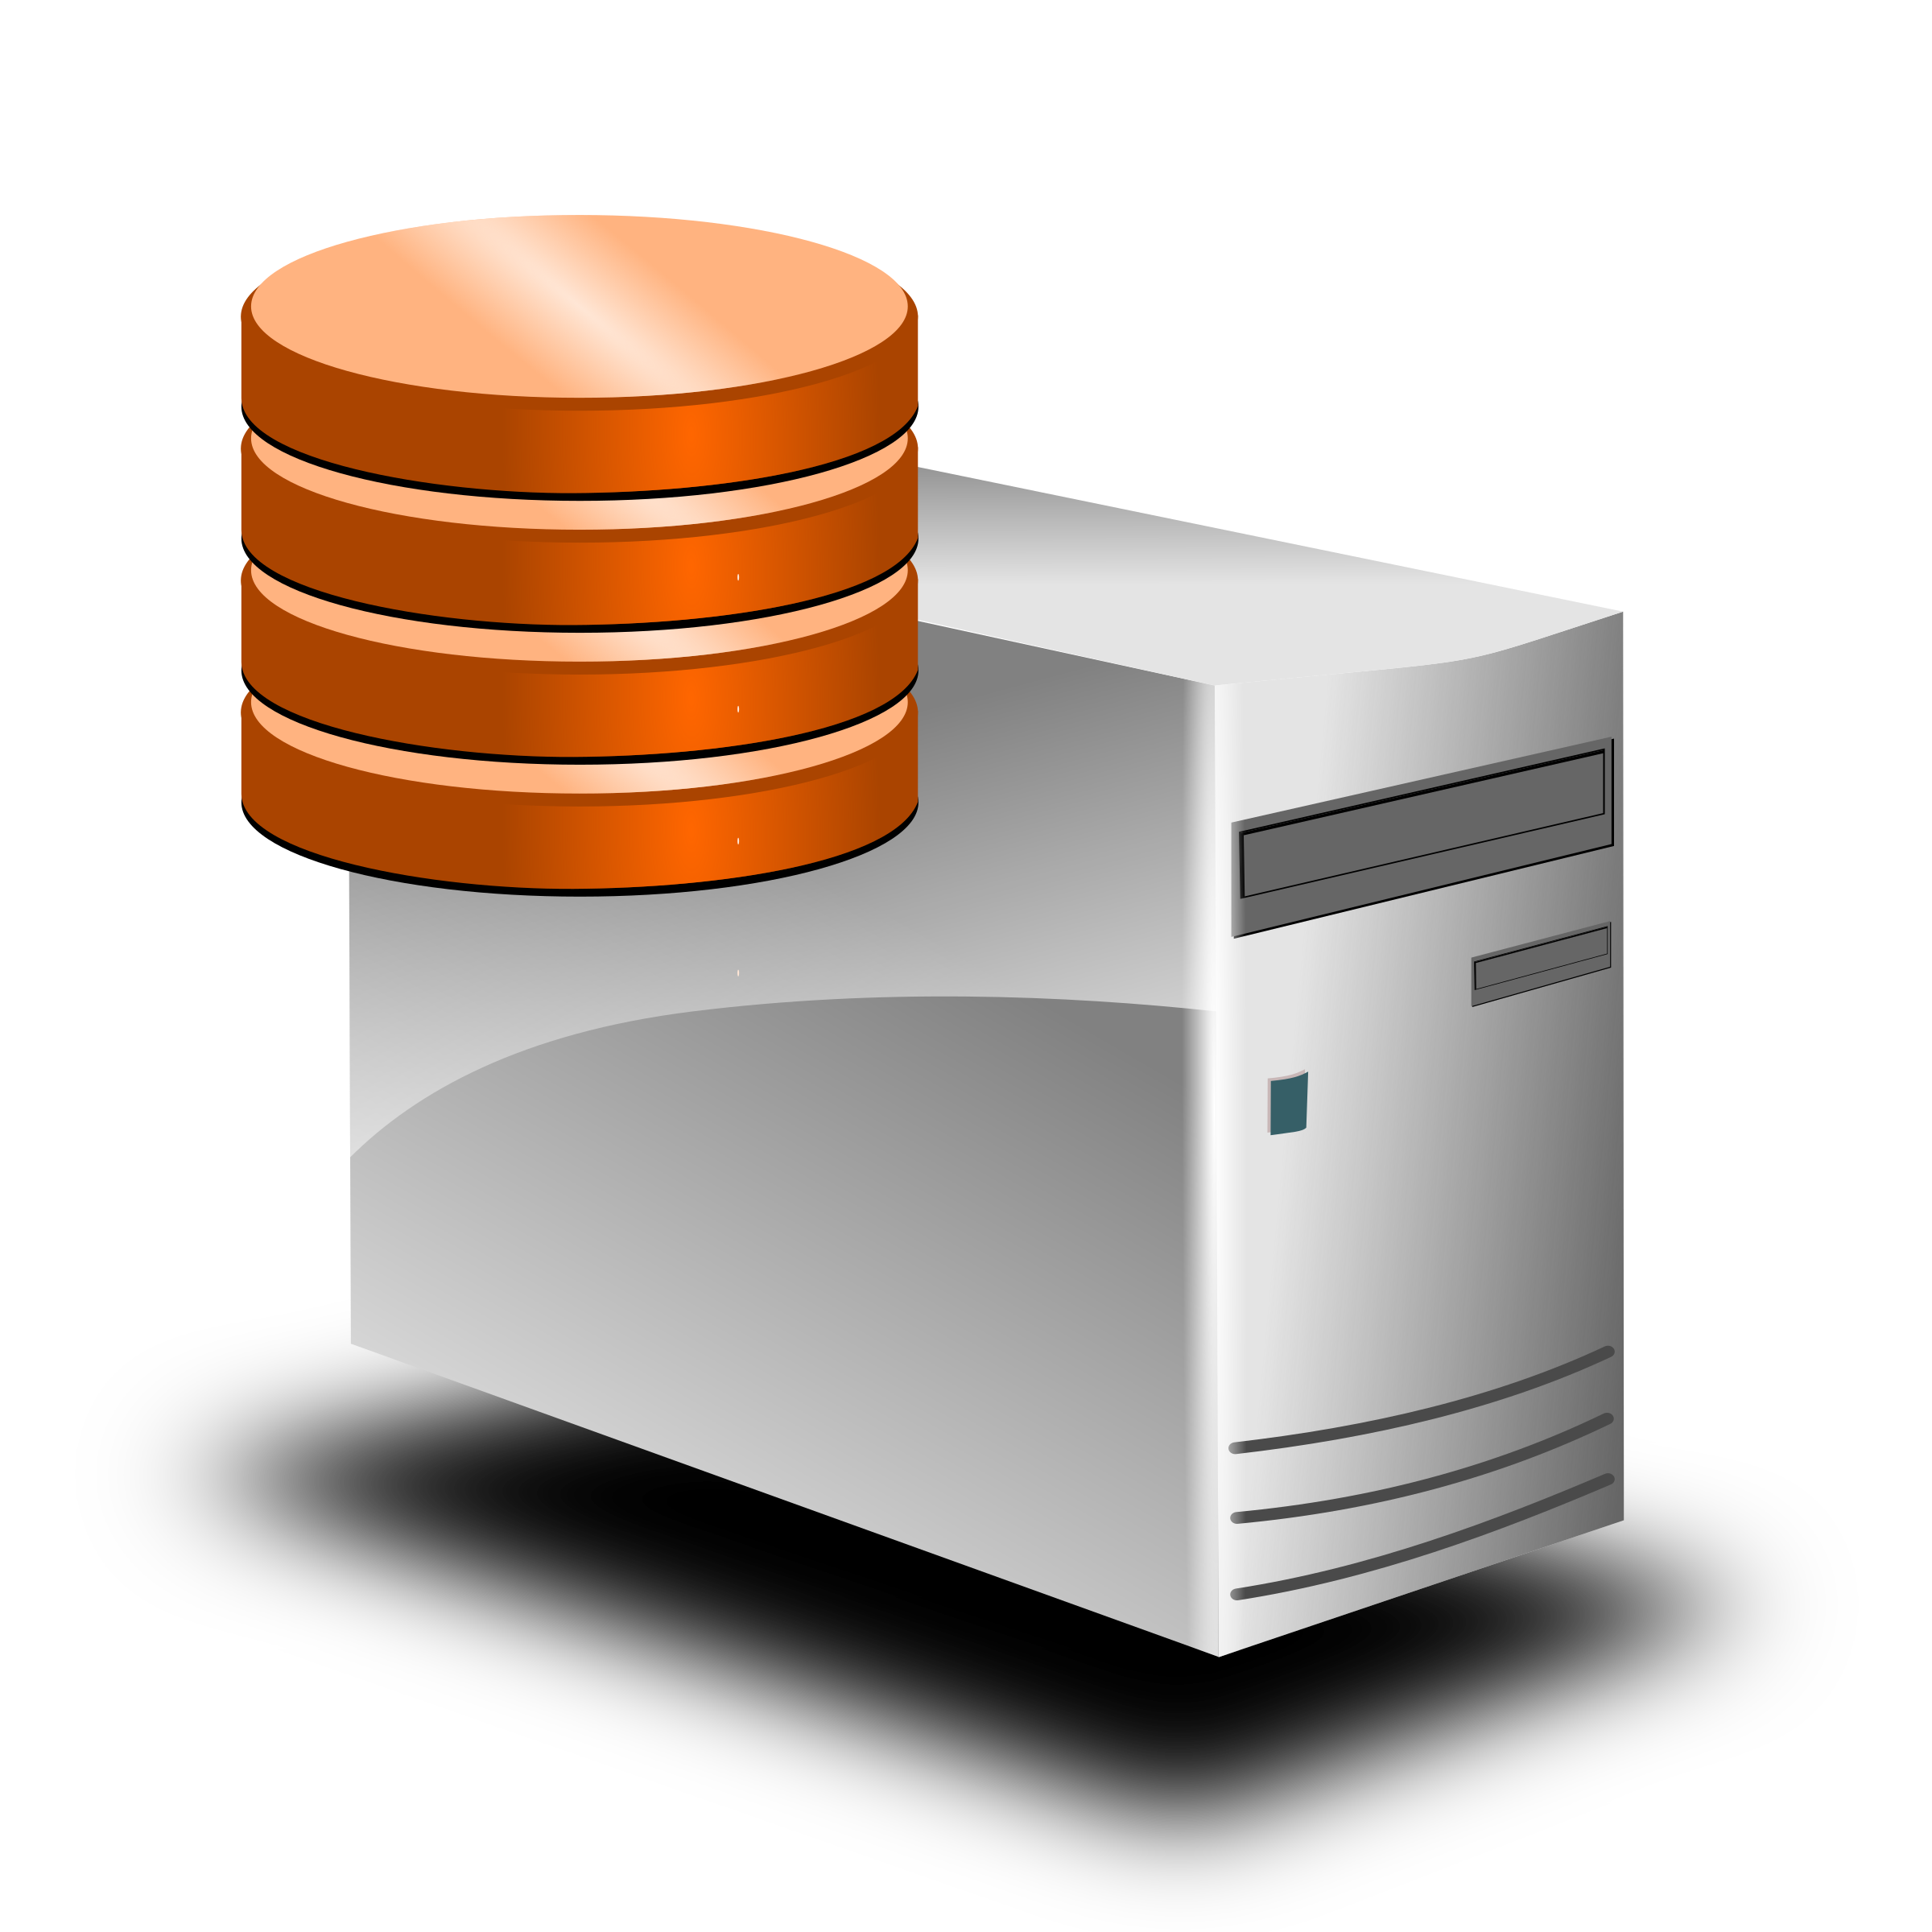


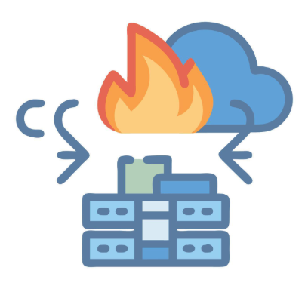
Without Version Control
Application Version 1.0
Application Version 1.0
Production (“Live”) server
Developer 1
Developer 2
Application Version 2.0
Production (“Live”) server
Developer 2

Slide 5
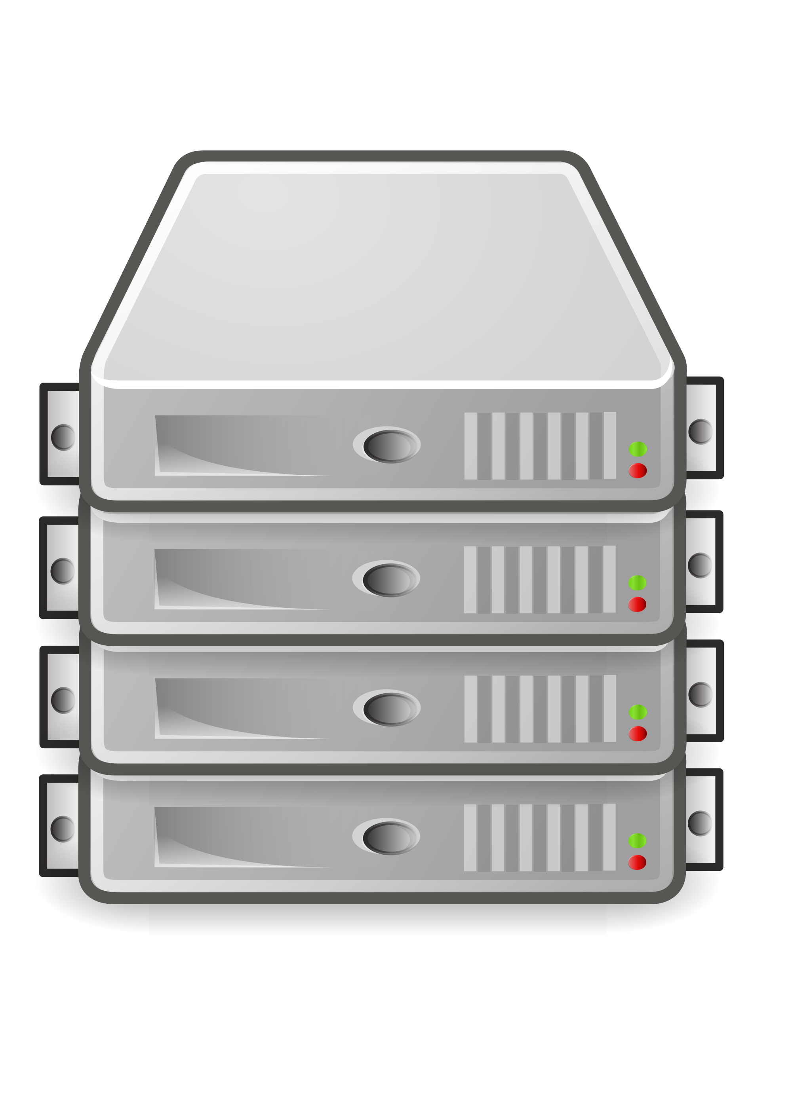
With Version Control
Application Version 1.0
Production (“Live”) server
Developer 1
Repository
Application Version 1.0
Application Version 2.0
Repository
Production (“Live”) server
Developer 2
Application Version 2.0
This Photo by Unknown Author is licensed under CC BY-NC

Slide 6
Centralized vs Distributed Version Control
Feature | Centralized Version Control (CVCS) | Distributed Version Control (DVCS)
Repository | One central repository | Full repository on every developer's machine
Internet / Network | Usually required for commit and synchronization | Usually not required for most operations
History | Stored mainly on the central server | Full history stored on every developer's machine
Speed | Depends on server/network communication | Most operations are local and faster
Backup | Depends heavily on the central server | Multiple copies provide redundancy
Collaboration | Developers depend on the central server | Developers can work independently and merge later
Offline Work | Limited | Fully supported
Examples | CVS, Subversion (SVN), Perforce, ClearCase, Visual SourceSafe (VSS), TFVC | Git, Mercurial, Bazaar, Darcs, Fossil, Monotone, GNU Arch

Slide 7
Git and GitHub
Git | GitHub
Distributed Version Control System (DVCS) | Cloud-based platform for Git repositories
Tracks changes in source code and files | Hosts Git repositories online
Runs locally on your computer | Provides online storage and collaboration
Maintains complete version history | Helps teams manage projects and contributions
Supports branching and merging | Provides Pull Requests, Issues, and Code Reviews
Works offline | Enables collaboration from different locations
Fast local operations | Provides web-based project management
Used through commands/tools such as git commit, git branch, git merge | Provides a web interface and collaboration features
Git is the version control technology | GitHub is a platform built around Git

Slide 8
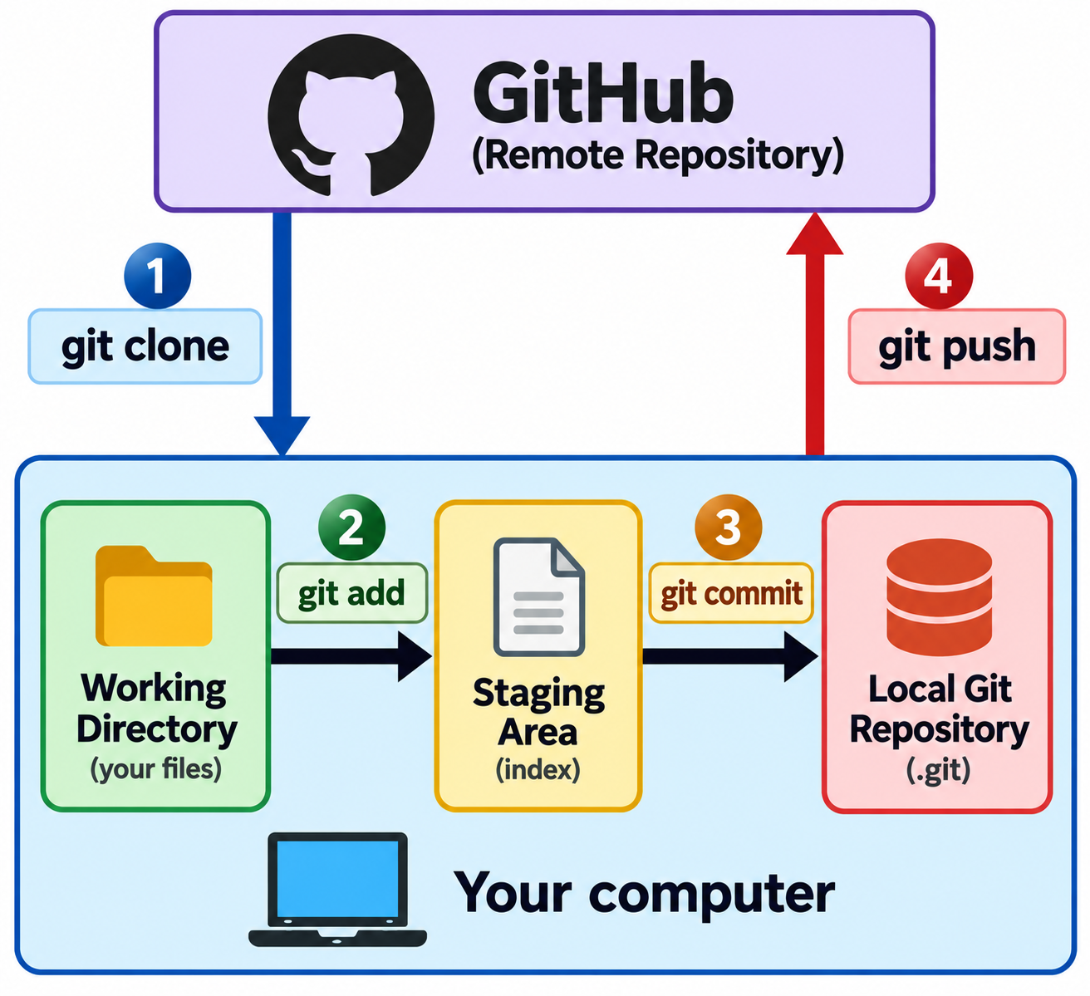
Git Steps

Slide 9
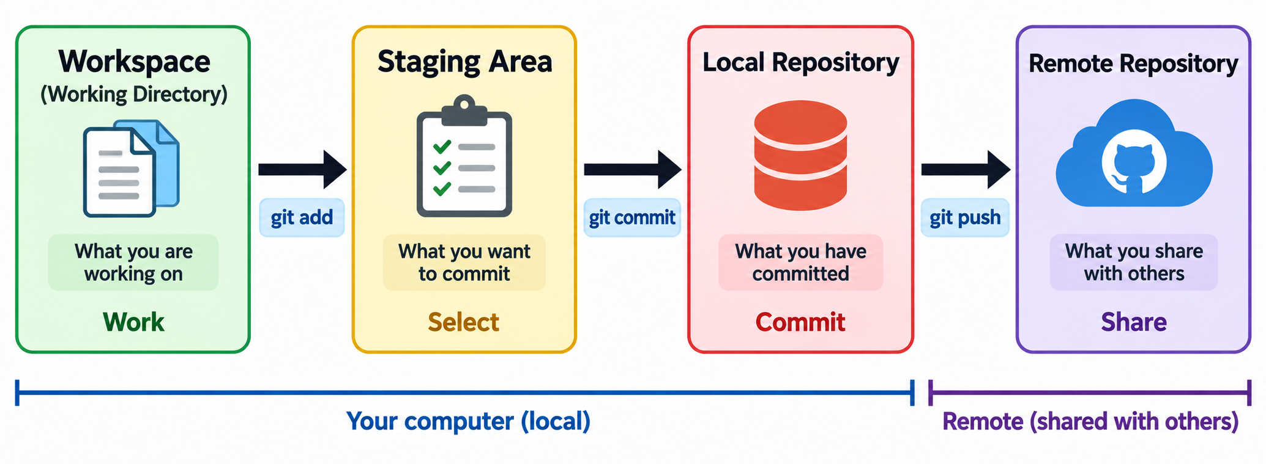
Git Areas

Slide 10
Creating a GitHub Repository
Go to https://github.com and log in to your account
Click the “+” icon at the top-right corner
Select New repository.
Enter the Repository name (example: demo)
Do not change anything else
GitHub will create the repository
We can now clone, add files, commit, and push code to this repository

Slide 11
Local Repository – Two Commands
git init command (Use to start a new project)
  Creates a new, empty Git repository in an existing project directory
  We start the project locally and then connect it to a remote repository if needed
• git clone command (Use for an existing project)
  Creates a local copy of an existing remote repository, including its files and Git history
  It also automatically sets up the remote repository as origin

Slide 12
Set Up Git to Work With GitHub
Before using Git, tell Git who you are - This information is stored with every commit you create
git config --global user.name “Atul Kahate“
git config --global user.email “newdelthis@gmail.com"

Slide 13
Generating a Personal Access Token (PAT)
Log in to GitHub
Click on your profile icon (top-right corner)
Select Settings
In the left sidebar, click Developer settings
Click Personal access tokens
Select Tokens (classic)
Click Generate new token
Enter a token name (description)
Set the expiration period
Select required permissions (scopes) such as repo
Click Generate token
Copy and store the token immediately (it will not be shown again)
Use this PAT instead of your GitHub password when performing operations like git push

Slide 14
On the Local Machine (Git) Terminal
cd ~
git clone https://github.com/newdelthis/demo.git
cd demo
nano Hello.java
git status
git add Hello.java
git commit -m "Added Hello.java“
git push origin main

Slide 15
Miscellaneous Git Commands
Command | Purpose | Example
git status | Show current state of repository | git status
git log | Show commit history | git log
git diff | Show differences between files | git diff
git pull | Fetch and merge updates from remote | git pull origin main
git fetch | Download changes without merging | git fetch origin
git remote -v | Show remote repositories | git remote -v
git reset | Undo staging or commits | git reset file1.txt
git rm | Remove a file from repository | git rm file1.txt
git stash | Temporarily save changes | git stash
git stash pop | Restore stashed changes | git stash pop

Slide 16
Branch and Merge
Original “main” Repository on GitHub
Branch D-1
Branch D-2
Merge
Merge into “main” branch

Slide 17
Branch and Merge Example – Basic Setup
Step | Action | Command
1 | Create a new repo | In GitHub, create a new repo named branch-test
2 | Clone it on the Linux machine | cd ~ git clone https://github.com/newdelthis/branch-test.git
3 | Create hello.py | cd branch-test nano hello.py
4 | Push it to GitHub | git add . git commit -m “Branch test – First commit” git push origin main

Slide 18
Branch and Merge Example
Step | Action | Command
1 | Create branches (-b means create) | git checkout -b d-1 git checkout -b d-2
2 | Switch to d-1 branch and complete developer 1’s work | git checkout d-1 nano hello.py Edit the line and add a line git add hello.py git commit -m "Developer-1 hello.py"
3 | Repeat for Developer 2 | git checkout d-2 nano hello.py Edit the line and add a line git add hello.py git commit -m "Developer-2 hello.py"

Slide 19
Branch and Merge Example
Step | Action | Commands
1 | Try merging d-1 branch into d-2 branch | git merge d-1 ERROR!
2 | Edit hello.py and resolve conflicts | nano hello.py and resolve conflicts
3 | Again add and commit | git add hello.py git commit -m “Conflict handled”
4 | Try merging again | git merge d-1 OK!
5 | Switch to main and merge branch 2 | git checkout main git merge d-2 git push origin main
6 | Remove other branches | git branch -d d-1 git branch -d d-2

Slide 20
Branch and Merge Commands
Command | Purpose | Example
git branch | List all branches in the repository | git branch
git branch branch_name | Create a new branch | git branch feature1
git checkout branch_name | Switch to an existing branch | git checkout feature1
git checkout -b branch_name | Create and switch to a new branch | git checkout -b feature2
git merge branch_name | Merge another branch into the current branch | git merge feature1
git branch -d branch_name | Delete a local branch | git branch -d feature1
git push origin branch_name | Push a branch to remote repository | git push origin feature1
git push origin --delete branch_name | Delete a remote branch | git push origin --delete feature1

Slide 21
Alternative: switch Command
Command | Purpose | Example
git switch branch_name | Switch to an existing branch (modern alternative to checkout) | git switch feature1
git switch -c branch_name | Create a new branch and switch to it | git switch -c feature2
git switch main | Switch back to the main branch | git switch main
git switch - | Switch to the previously used branch | git switch -
git switch --detach commit_id | Switch to a specific commit (detached HEAD state) | git switch --detach a1b2c3d

Slide 22
Real-life GitHub Branch -> Pull Request -> Merge
Assumptions
  main = stable production code
  Developer 1 works on feature-login
  Developer 2 works on feature-report
  GitHub is the central remote repository
Step 1: Create a GitHub repo, e.g. my-project
  Initial state
    GitHub Repository
    └── main

Slide 23
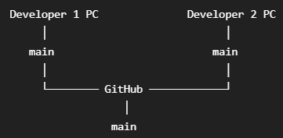
GitHub Branch -> Pull Request -> Merge
Step 2: Each developer clones the repository
  Developer 1
    git clone https://github.com/user/my-project.git
    cd my-project
  Developer 2
    git clone https://github.com/user/my-project.git
    cd my-project
  Now both have a local copy

Slide 24

GitHub Branch -> Pull Request -> Merge
Step 3: Developer 1 creates a new branch
  Developer 1
    git switch -c feature-login
    # Edits files and commits
    git add .
    git commit -m "Add login feature“ -> Only exists in local repo of Developer 1
    Pushes to GitHub
    git push -u origin feature-login
    Creates a pull request, meaning: my work is done, please review and merge in main
Repository
├── main
└── feature-login

Slide 25
GitHub Branch -> Pull Request -> Merge
Step 4: Other developers review
  They might suggest changes, e.g. Developer 2: "Please fix the password validation"
  Developer 1 may make local code changes and
    git add .
    git commit -m "Fix password validation"
    git push
  No new PR is needed – the previous one is fine
  GitHub checks and informs if there is a merge conflict, if yes, need to resolve it
  After approval, the reviewer clicks: Merge pull request
  GitHub performs the merge, so that we only have the main branch
  Now the GitHub and local branches can be deleted (git switch main and git branch -d feature-login)

